Slide 1
Contending With Carveouts: How and Why Charge-Based Exclusions Hamper Reform
Sarah Staudt, Director of Policy and Advocacy, Prison Policy Initiative
Jeannette Zanipatin, California State Director, Drug Policy Alliance
Laurie Jo Reynolds, Coordinator, Chicago 400 Alliance

Slide 2
What is a Carveout?
The “except” or “other than” in criminal legal system reforms that refers to some charge or set of charges.
More generally, a refusal to address or touch needed reform for certain categories of crimes, even while pursuing it for less serious ones.
Often, reforms focus on the non-non-nons: “non-violent,” “non-sexual,” “non-serious.”

Slide 4
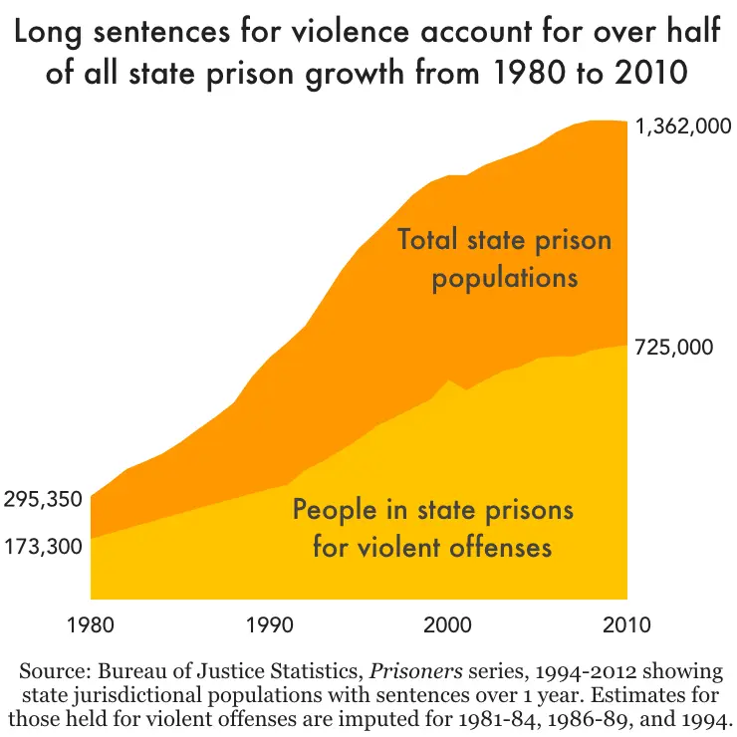
How we got here: the explosion of people in prison for violent crimes
The number of people in state prison for violent offenses increased by over 300% between 1980 and 2009
A huge variety of “tough on crime” laws contributed to this rise: “3 strikes”, “truth-in-sentencing”, automatic transfer of youth to adult court, and the end of discretionary parole in many states.

Slide 5
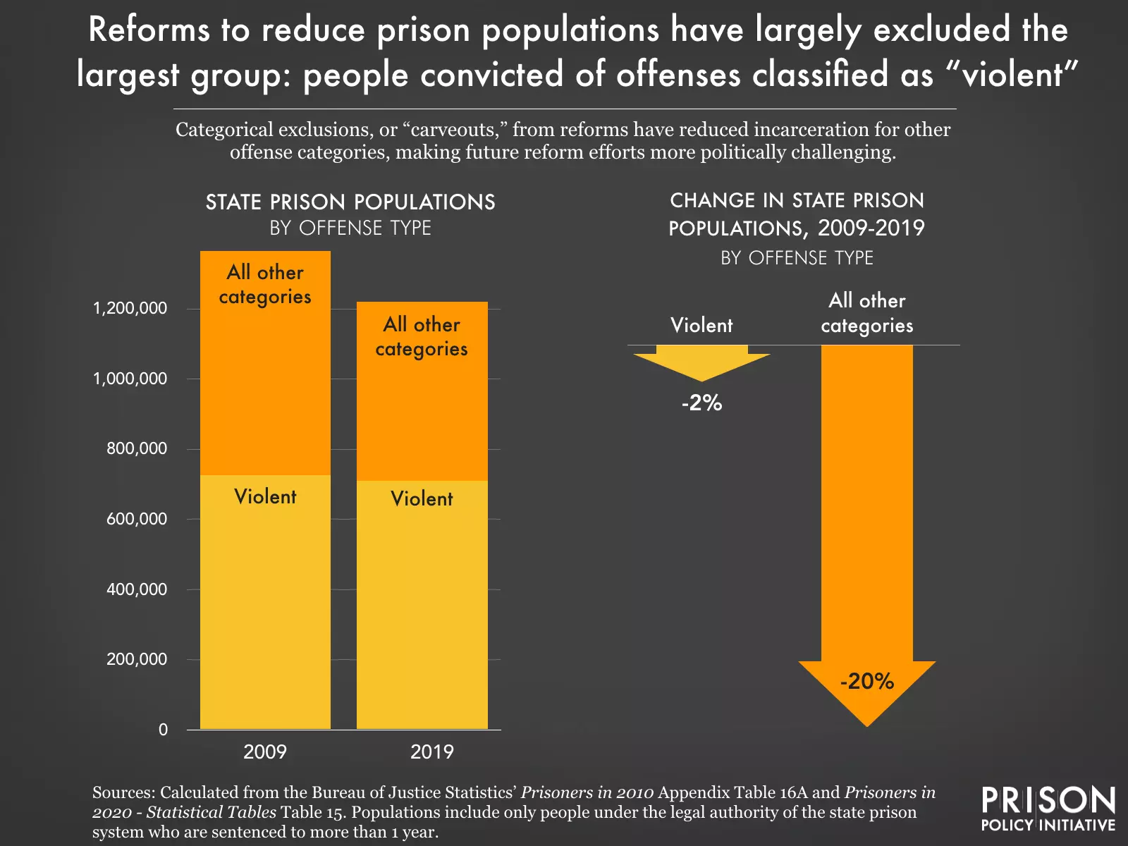
The Stakes: How Carveouts are Stifling Progress
Between 1981 and 2016, time served for sexual assault and robbery nearly doubled, and time served for murder tripled.
Despite progress addressing mass incarceration, there has been almost no change in the prison population for people accused of violent crimes

Slide 6
Common arguments in favor of carveouts - and strategies to deal with them

Slide 7
Argument #1: “Just trust me and wait”
“We have to start reforms with nonviolent charges, and we’ll ‘come back’ for more serious charges later”

Slide 8
Why we often can’t “come back” for more serious charges
The logic of carveouts reinforces the flawed logic of incarceration.
Pursuing a carveout strategy leaves behind a group of people that policymakers and the public traditionally have the most trouble empathizing with.
Carveouts then require that reforms down the line only benefit the group of people most easily vilified and othered – it becomes very unlikely that such a law will pass.

Slide 9
Strategies for pushing to address violent charges now, not later
It can be helpful to remind policymakers of how difficult it would be to “come back” for people with more serious charges.
Ask for what you want – it’s sometimes better to avoid over-anticipating policymakers objections and negotiating against yourself. Instead, put policymakers on the hook to justify and explain why they want exclusions.

Slide 10
Argument #2: “What about the victims?”
“Victims of crime want people with violent charges excluded from reform”

Slide 11
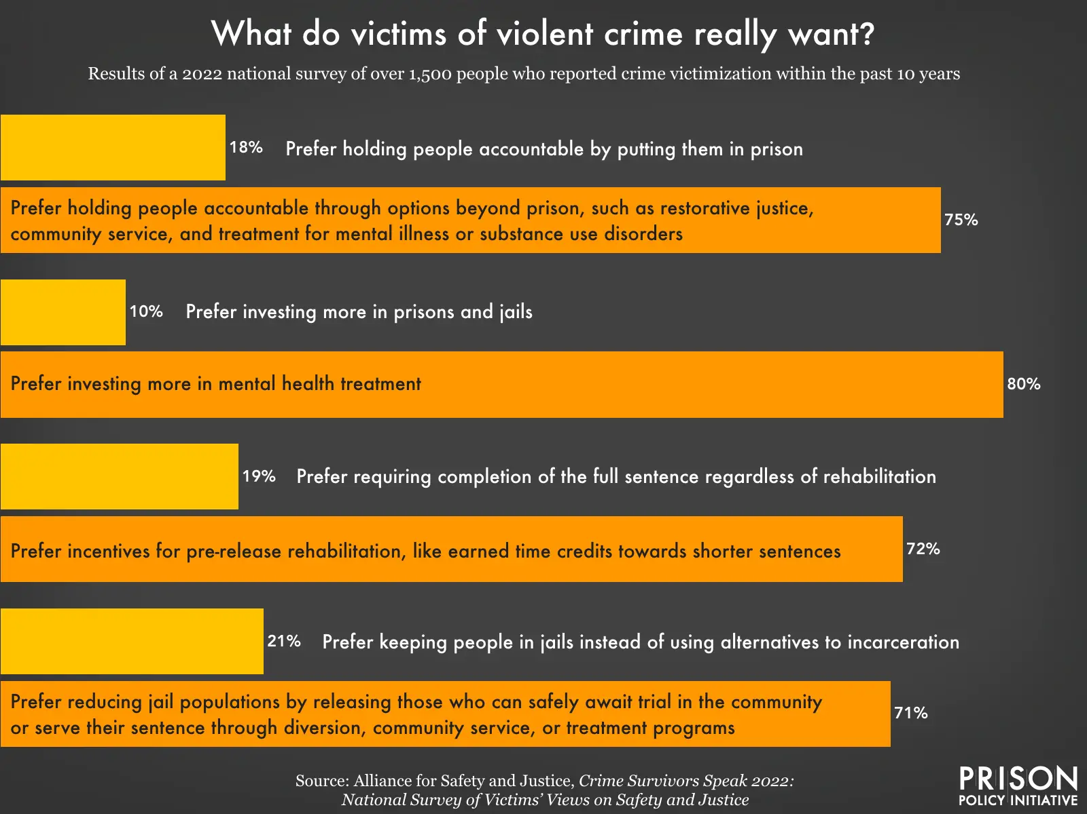
Surveys show that violent crime victims aren’t a monolith – and many want non-prison solutions

Slide 12
Strategies for working with victims’ groups and advocates
Where possible, find out what the victims groups in your area actually do think about reforms, and whether they’ve been directly consulted. You may find unlikely allies.
Organize and empower people who have been victims of crime who do support reform (often, these are the same people impacted by the criminal legal system).
Extreme and carceral-minded victims groups often claim to speak for every victim; you can undermine their power by providing another victim’s voice who disagrees with them.

Slide 13
Argument #3: “Innocent people are going to get hurt”
“Including people charged with violent crimes in reforms will harm public safety”

Slide 14
People serving long prison sentences for violent crime are among the least “risky” groups of people.
Lowest re-arrest rate of any group.
Limited studies of release of lifers and others serving extreme sentences show remarkable results
“The Ungers” – nearly 200 people charged with sex-related and violent crimes in Maryland were released in 2012. Six years later, only 5 had returned to prison for any reason – a 3% rate.
Safe and Just Michigan examined 1,000 people convicted of homicide and sex offenses released between 2007-2010. Less than 1% returned to prison within 3 years.

Slide 15
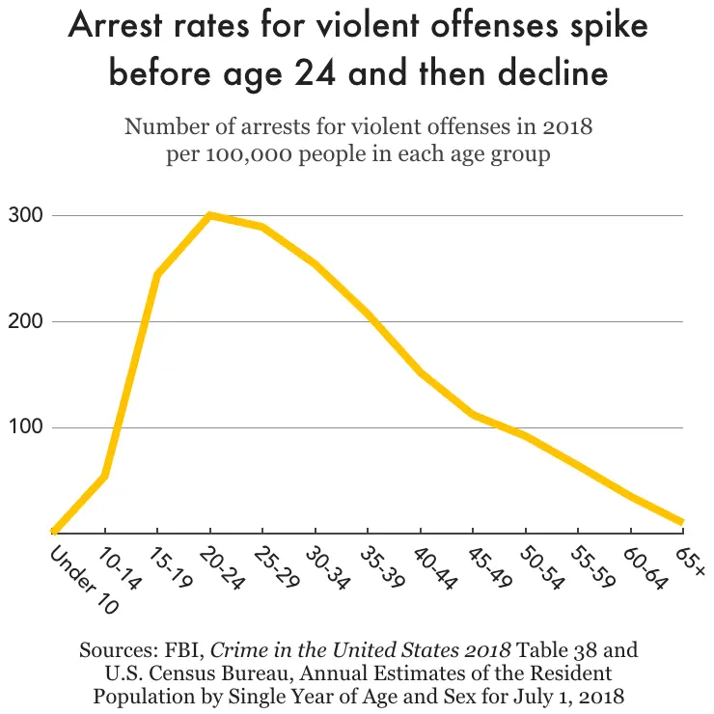
Age and Criminal Behavior

Slide 16
An aside: talking to policymakers about recidivism
Many recidivism rates you may be faced with from opponents include lots of post-release behavior that is non-criminal, non-dangerous, and not what most people think of when they hear the word “recidivism.”
Check whether
The rates in question are re-ARREST rates, re-CONVICTION rates, or re-INCARCERATION rates.
Whether the rates include re-arrest for anything or only for serious offenses
Whether they include technical violations of release
How long the follow-up period is.
Remind policymakers about reporting bias – we hear all the bad stories, but the good stories are rarely reported on, giving us a skewed understanding of recidivism.

Slide 17
Strategies for dealing with the “Willie Horton Effect”
Policymakers often believe they will be strongly blamed for any negative outcomes.
Offer continued and ongoing support from your organizing when a negative outcome does occur.
Arm them with responses:
Positive outcome stories
Perceived safeguards against negative outcomes, like discretion by decision makers and risk evaluation methods.
Statistics (though these can be less helpful than other kinds of arguments)

Slide 18
Argument #4: “People ‘like that’ don’t deserve my mercy”
“People convicted of serious offenses do not deserve mercy or reform”

Slide 19
People charged with serious crimes are individuals with individual stories
Everyone grows and changes, and most reforms include discretionary measures to allow decisionmakers to look at each person’s case individually.
Carveouts remove, rather than strengthen, that discretion.
“Violent” doesn’t always mean violent:
Especially when carveouts are written with broad language like “violent,” “serious,” or similar language, there may not be a clear statutory definition of what charges that encompasses.
If there has to be a carveout, you may be better served by a clear list of charges so that the carveout can’t be expanded to include more people than intended.

Slide 20
Strategies to help policymakers empathize
Wherever possible, put policymakers in direct or close to direct contact with incarcerated and formerly incarcerated people.
Consider asking your legislature to allow public testimony from inside prisons.
Tell stories from multiple perspectives: make sure that policymakers hear from families.

Slide 21
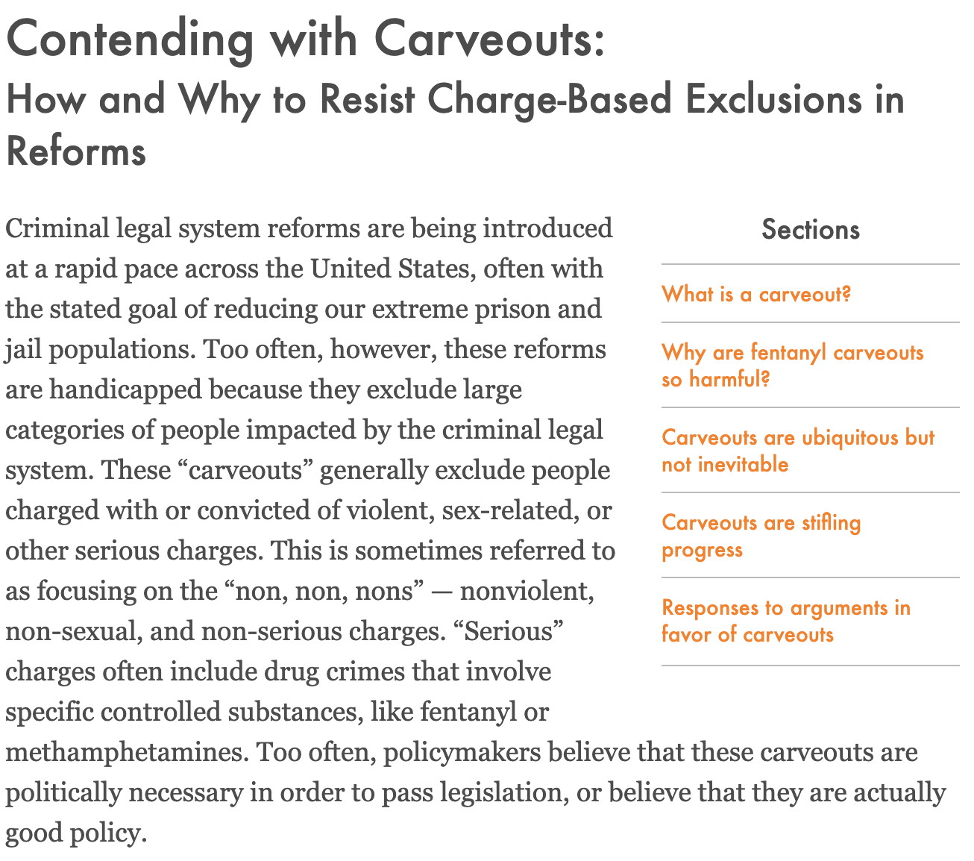
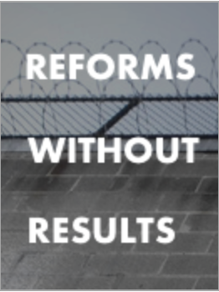
Prison Policy Initiative Resources
Carveouts Toolkit – includes the counterarguments talked about in this presentation in one easy-to-use document.
Reforms Without Results – comprehensive 2020 report about why policymakers should avoid carveouts

Slide 22
Contact
Sarah Staudt
Director of Policy and Advocacy
sstaudt@prisonpolicy.org
Emmett Sanders
Policy and Advocacy Associate
esanders@prisonpolicy.org

